Slide 1
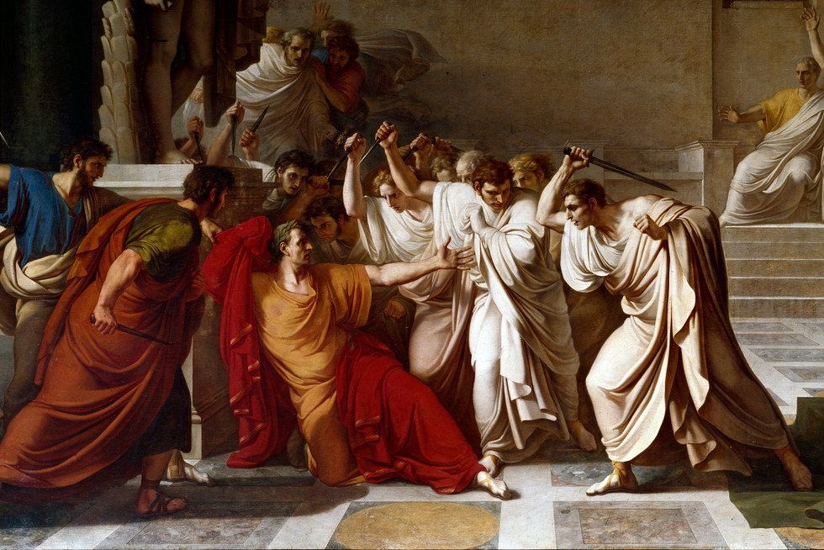
The Land Crisis
GOAL/S: Identify and describe the causes and effects of the ‘Land Crisis’
Week 3, Lesson 4

Slide 2
Upcoming Lessons:
We will be learning the historical context in which Tiberius and Gaius Gracchus came to power. It is important to understand this context, to understand these key people and the society in which they operated.
Thursday: Rome after the Punic Wars AND the Populares/Optimates
Friday: The Land Crisis

Slide 3
The Ancient Rome 'Land Crisis' refers to a period of social and economic turmoil in the Roman Republic, particularly during the 2nd century BCE. It was characterized by the concentration of land in the hands of a wealthy elite, leading to the displacement of small landholders and contributing to widespread economic and social inequality.

Slide 4
ACTIVITY
Read through the following information
Take down key points about the land crisis

Slide 5
A particular problem had arisen at this time caused by how the traditional Roman military recruitment system worked. Since the birth of the Roman republic nearly 400 years before, the soldiers of Rome’s armies were made up of Roman citizens. Each citizen was responsible for paying for their own weapons and armour.
This was only possible if they owned land, on which they could farm and earn money.
These citizen soldiers were then expected to be on military campaign during the year and then only return to their farms and families once a particular war had finished. This meant that such men could be away for years at a time.
Unfortunately, the absence of these men from their farms often meant that the families left behind struggled to supply the manual labour required to grow enough crops to pay their debts. Over time, many families were forced to sell their farms, which were often bought up by wealthier nobles who had not gone to war.
Then, when the soldiers returned home from war, they neither had their farms nor an income to feed themselves or their families. Many of these poorer people were forced to move to the city of Rome, where they hoped to find work.

Slide 6
Over time, the number of unemployed poor families had grown, and they had started approaching senators to create laws to help them get back on their feet again. Mostly, these people wanted their farms back.
Many believed that the Roman government owed them this much since these men had been fighting and dying for Rome during the brutal Punic Wars.
However, the Senate was reluctant to change the situation because many of the senators were the same nobles who had purchased the farms from the poorer families in the first place.
These wealthy elites, who were often part of the equites social group, were earning huge profits from these lands, as they had combined them into huge agricultural plantations called latifundia.
Furthermore, these nobles had no interest in offering the poorest Roman citizens paid work on these farms, as that would require the nobles to pay them wages, which would have been expensive.
Instead, the equites had purchased thousands of foreign slaves to do all of the necessary manual labour, which was far cheaper than hiring Romans as employees.

Slide 7

ACTIVITY – Causes of the Land Crisis
Create a mindmap or diagram of the following 4 causes and 5 effects of the Land Crisis

Slide 8
The Land Crisis

Slide 9
TEACHER ONLY – Causes of the Land Crisis
Agrarian Concentration:
Wealthy landowners, particularly members of the senatorial class, amassed large estates through conquests and land acquisitions.
This led to the consolidation of agricultural land into the hands of a few, contributing to the marginalization of small landholders.
Slave Labor and Latifundia:
The widespread use of slave labor on large estates (latifundia) made it economically challenging for small landholders to compete.
Wealthy landowners could produce goods more efficiently, leading to the decline of small farms.
Military Service and Economic Hardships:
Roman citizens who served in the military often faced economic hardships upon returning home.
Many small landowners, burdened by debt and unable to compete with larger estates, were forced to sell their land.
Lack of Legal Protections:
The absence of effective legal safeguards for small landholders allowed powerful creditors to exploit their financial vulnerabilities.
This lack of protection contributed to the displacement of many citizens from their land.

Slide 10
TEACHER ONLY – EFFECTS of the Land Crisis
Economic Disparities:
The concentration of land in the hands of a wealthy elite widened economic disparities.
The wealthy class accumulated immense wealth while the landless population struggled to secure stable livelihoods.
Social Unrest and Discontent:
The displacement of small farmers fueled social unrest and created a discontented class of landless citizens.
This discontent became a potent force in Roman politics, giving rise to populist leaders advocating for land reforms.
Military Implications:
Discontented veterans, unable to secure land upon their return, posed a potential threat to social stability.
The military implications of the Land Crisis were evident in the formation of armies led by populist leaders, seeking to address the grievances of the landless.
Political Reforms:
The Land Crisis played a pivotal role in shaping political agendas, leading to proposed reforms aimed at redistributing land and addressing the economic grievances of the dispossessed.
The Rise of the Gracchus Brothers:
Tiberius and Gaius Gracchus, influenced by the Land Crisis, emerged as advocates for land reforms and champions of the dispossessed.
Their proposed reforms aimed to limit landownership, distribute public land to the landless, and address the root causes of the crisis.

Slide 11
ACTIVITY – Source Analysis
Using the worksheet provided, analyse 3 written sources about the Land Crisis.
This must be completed by the end of the lesson.

